Slide 1
Landscape Practice for Biodiversity in Vertical Greenery
Empirical Mapping Biodiversity Assessment of 3D Ecological Performance
Ren Junyao

Slide 2
Research Context
Background: In landscape architecture, data-integrated modeling of three-dimensional ecological performance is increasingly important. However, there is often a gap between the expected ecological benefits of vertical landscape designs and the actual outcomes observed in reality. Recognizing and understanding this discrepancy is a crucial first step for improving modeling accuracy and guiding future optimizations.
Research Question: Does incorporating a vertical dimension in landscape design truly enhance biodiversity at the neighborhood scale? This project specifically asks whether existing vertical greenery installations are effectively improving local biodiversity.
Role of Data Visualization: Employ two complementary visualization idioms to explore the data. Empirical spatial mapping provides a 3D perspective, helping us visualize how biodiversity is distributed across the site’s vertical and horizontal spaces. In parallel, statistical charts (graphs) are used to quantify relationships in the data, allowing to examine correlations between design proposed performance and biodiversity outcomes.

Slide 3
Method
Node Definition:
Identify each discrete planted patch within the study area as a “node.” Each node represents a potential habitat unit capable of supporting biodiversity.
Predicted Biodiversity Score:
Estimate a biodiversity score for each node based on its design characteristics. Nodes are weighted according to the presence and abundance of plant species known to attract wildlife (habitat-supporting plants), yielding a predicted biodiversity index for each node.
On-Site Biodiversity Survey:
Conduct field surveys along predefined transect routes to gather real-world data. For every node, record all observed species and the number of individuals. Using these observations, calculate the actual biodiversity index of each node (reflecting the node’s real ecological performance).
Comparison & Correlation Analysis:
Compare the predicted scores with the observed biodiversity indices for all nodes. Analyze the relationship (correlation) between expected and actual outcomes to evaluate the accuracy of the predictions. This step helps in assessing whether the vertical landscape design has met its biodiversity improvement goals and in discussing the impact of vertical greenery on local biodiversity.

Slide 4
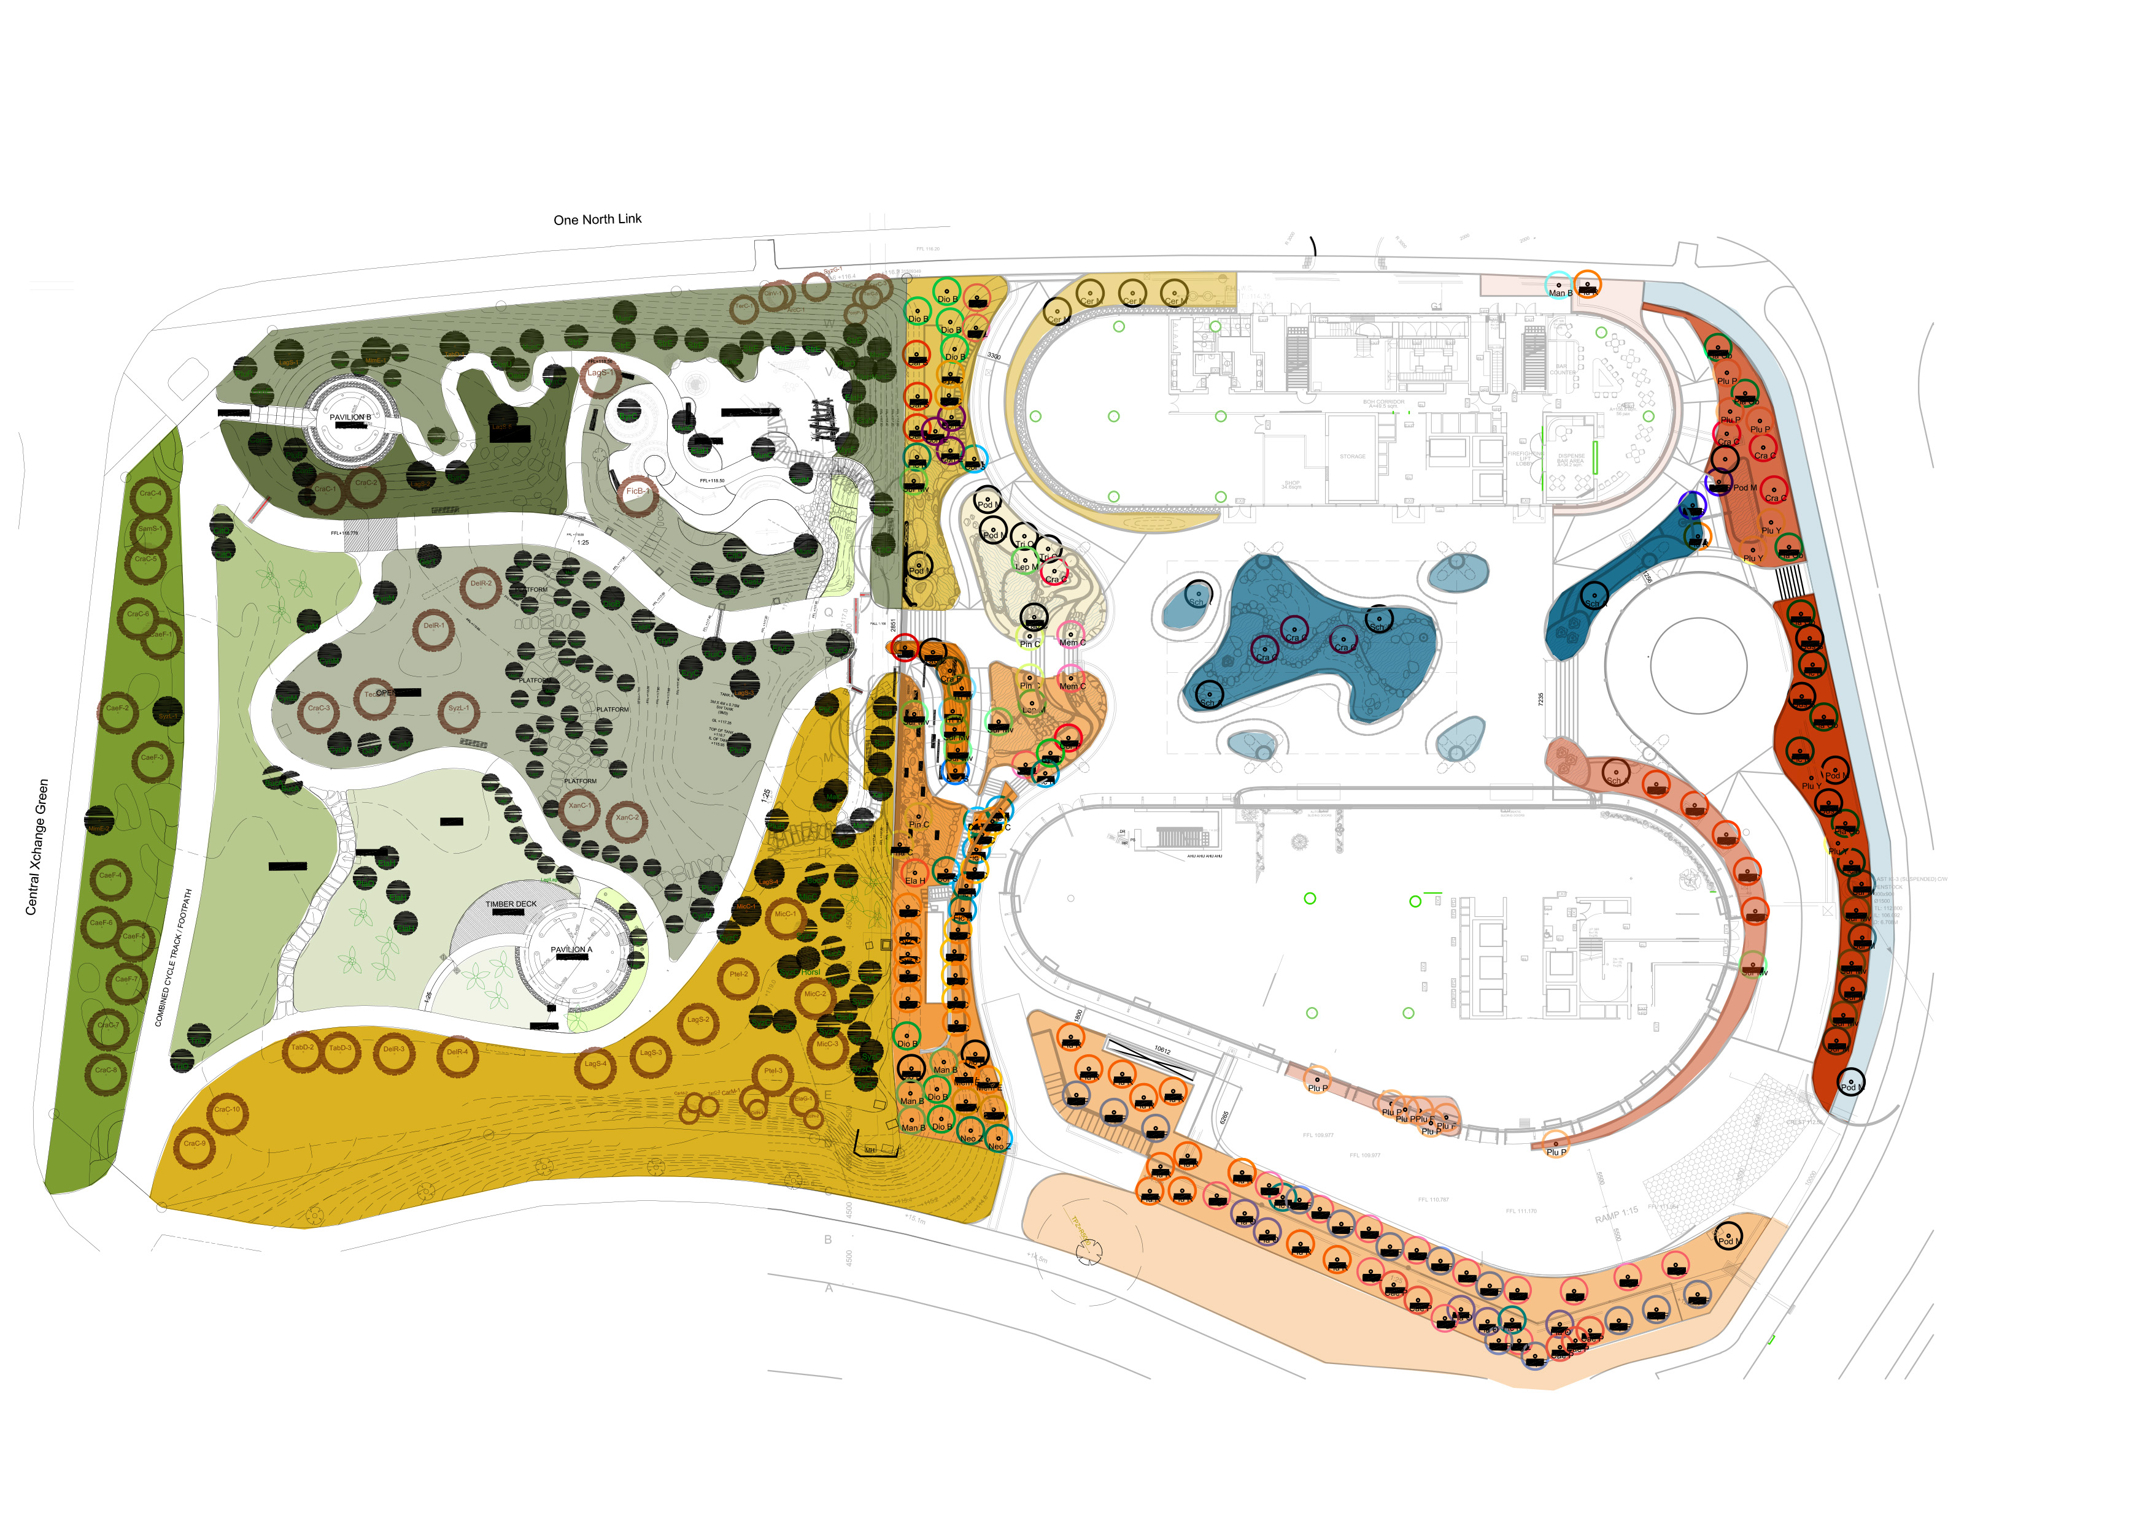
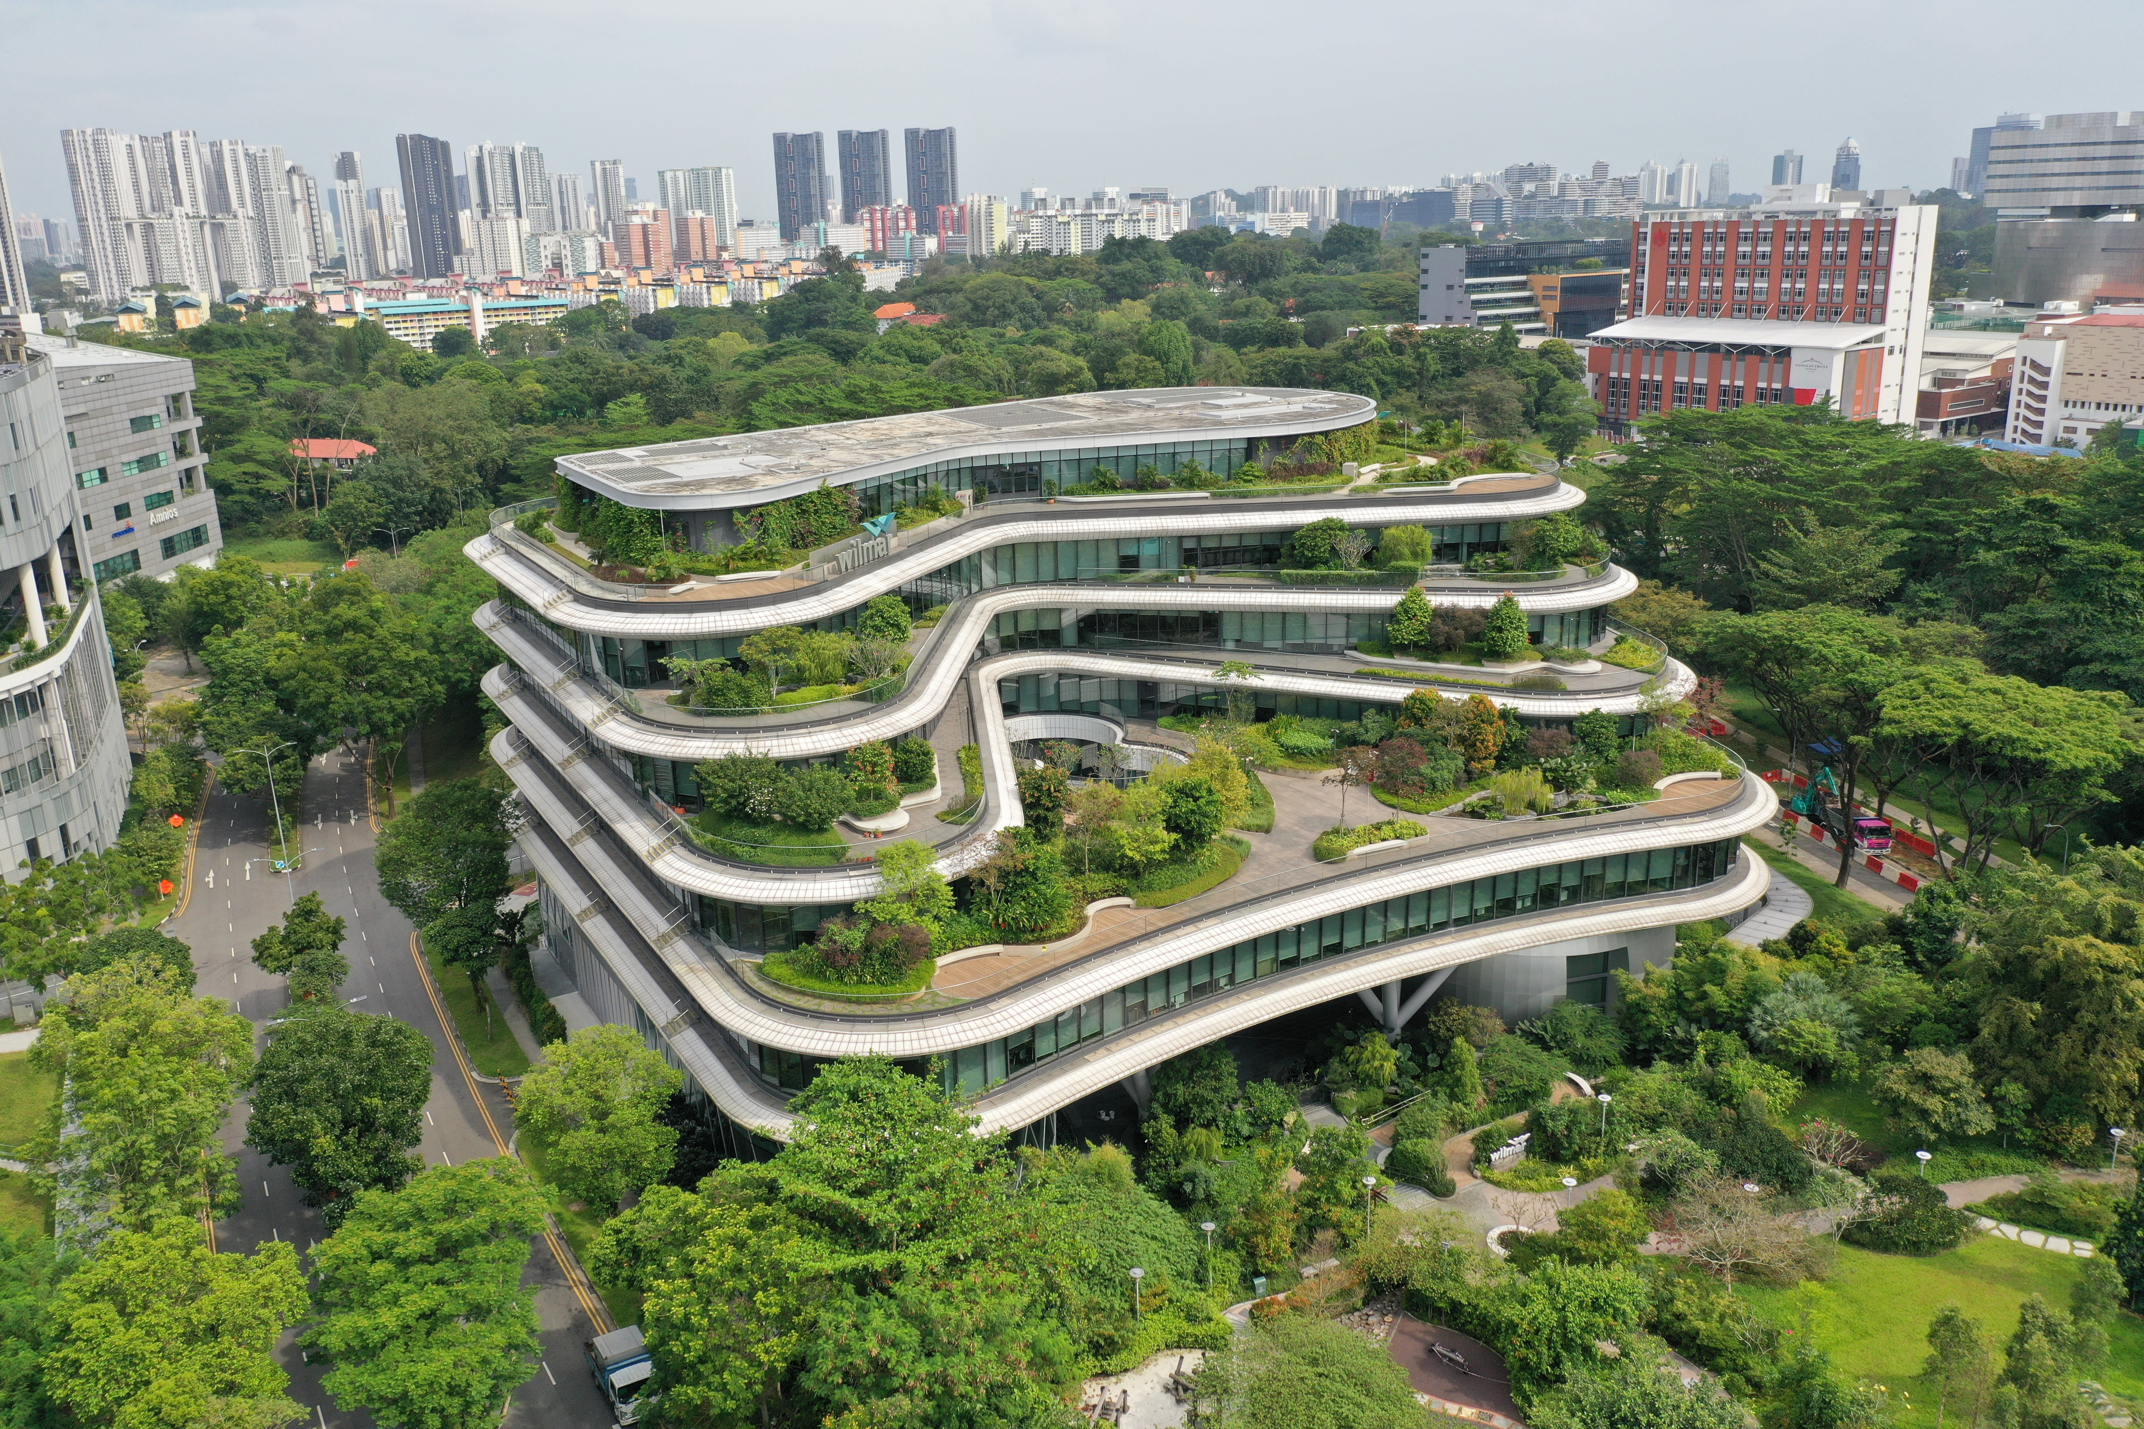
Data – Case Study Site & Node Definition
Case Study Site: The Wilmar Headquarters building at one-north was selected as the case study. This site features extensive vertical greenery, making it ideal for examining how 3D landscape design affects biodiversity.
Node Identification: Using the building’s landscape design plans, delineated every planted patch as a separate node. In practice, this means each green wall segment, rooftop garden, or ground-level planting area was marked out as an individual unit for analysis. These nodes form the basis of biodiversity assessment, as each is considered a distinct habitat area.

Slide 5
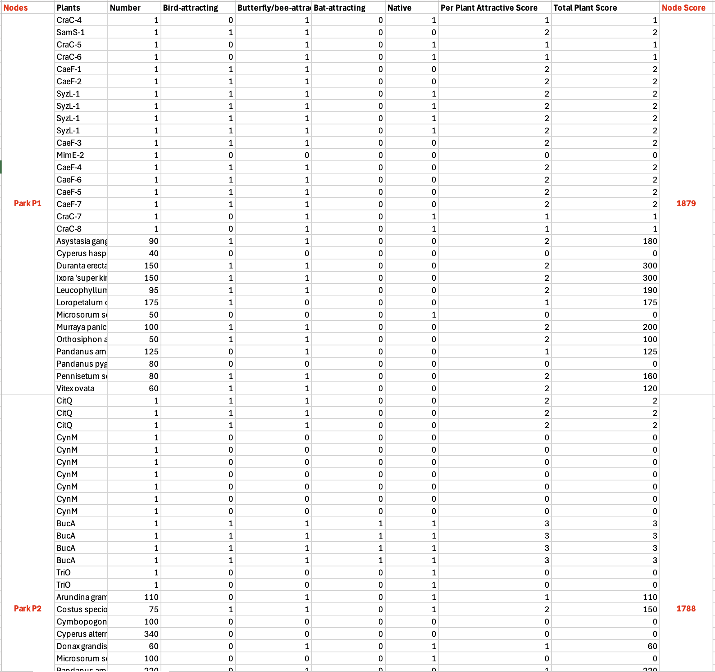
Data – Predicted Biodiversity Scores
Habitat Value Scoring: For each identified node, a predicted biodiversity score was calculated from the plants design data. The scoring method accounts for the composition of plant species in that node – nodes with a higher proportion of wildlife-attracting plants (species that provide food or habitat for birds, insects, etc.) receive higher scores.
Expected Biodiversity Index: The result is a predicted biodiversity index for every node. This index represents the expected ecological performance of that node before observing the actual fauna.
Essentially, it is a hypothesis of how well each patch should support biodiversity based on its vegetation characteristics.

Slide 6
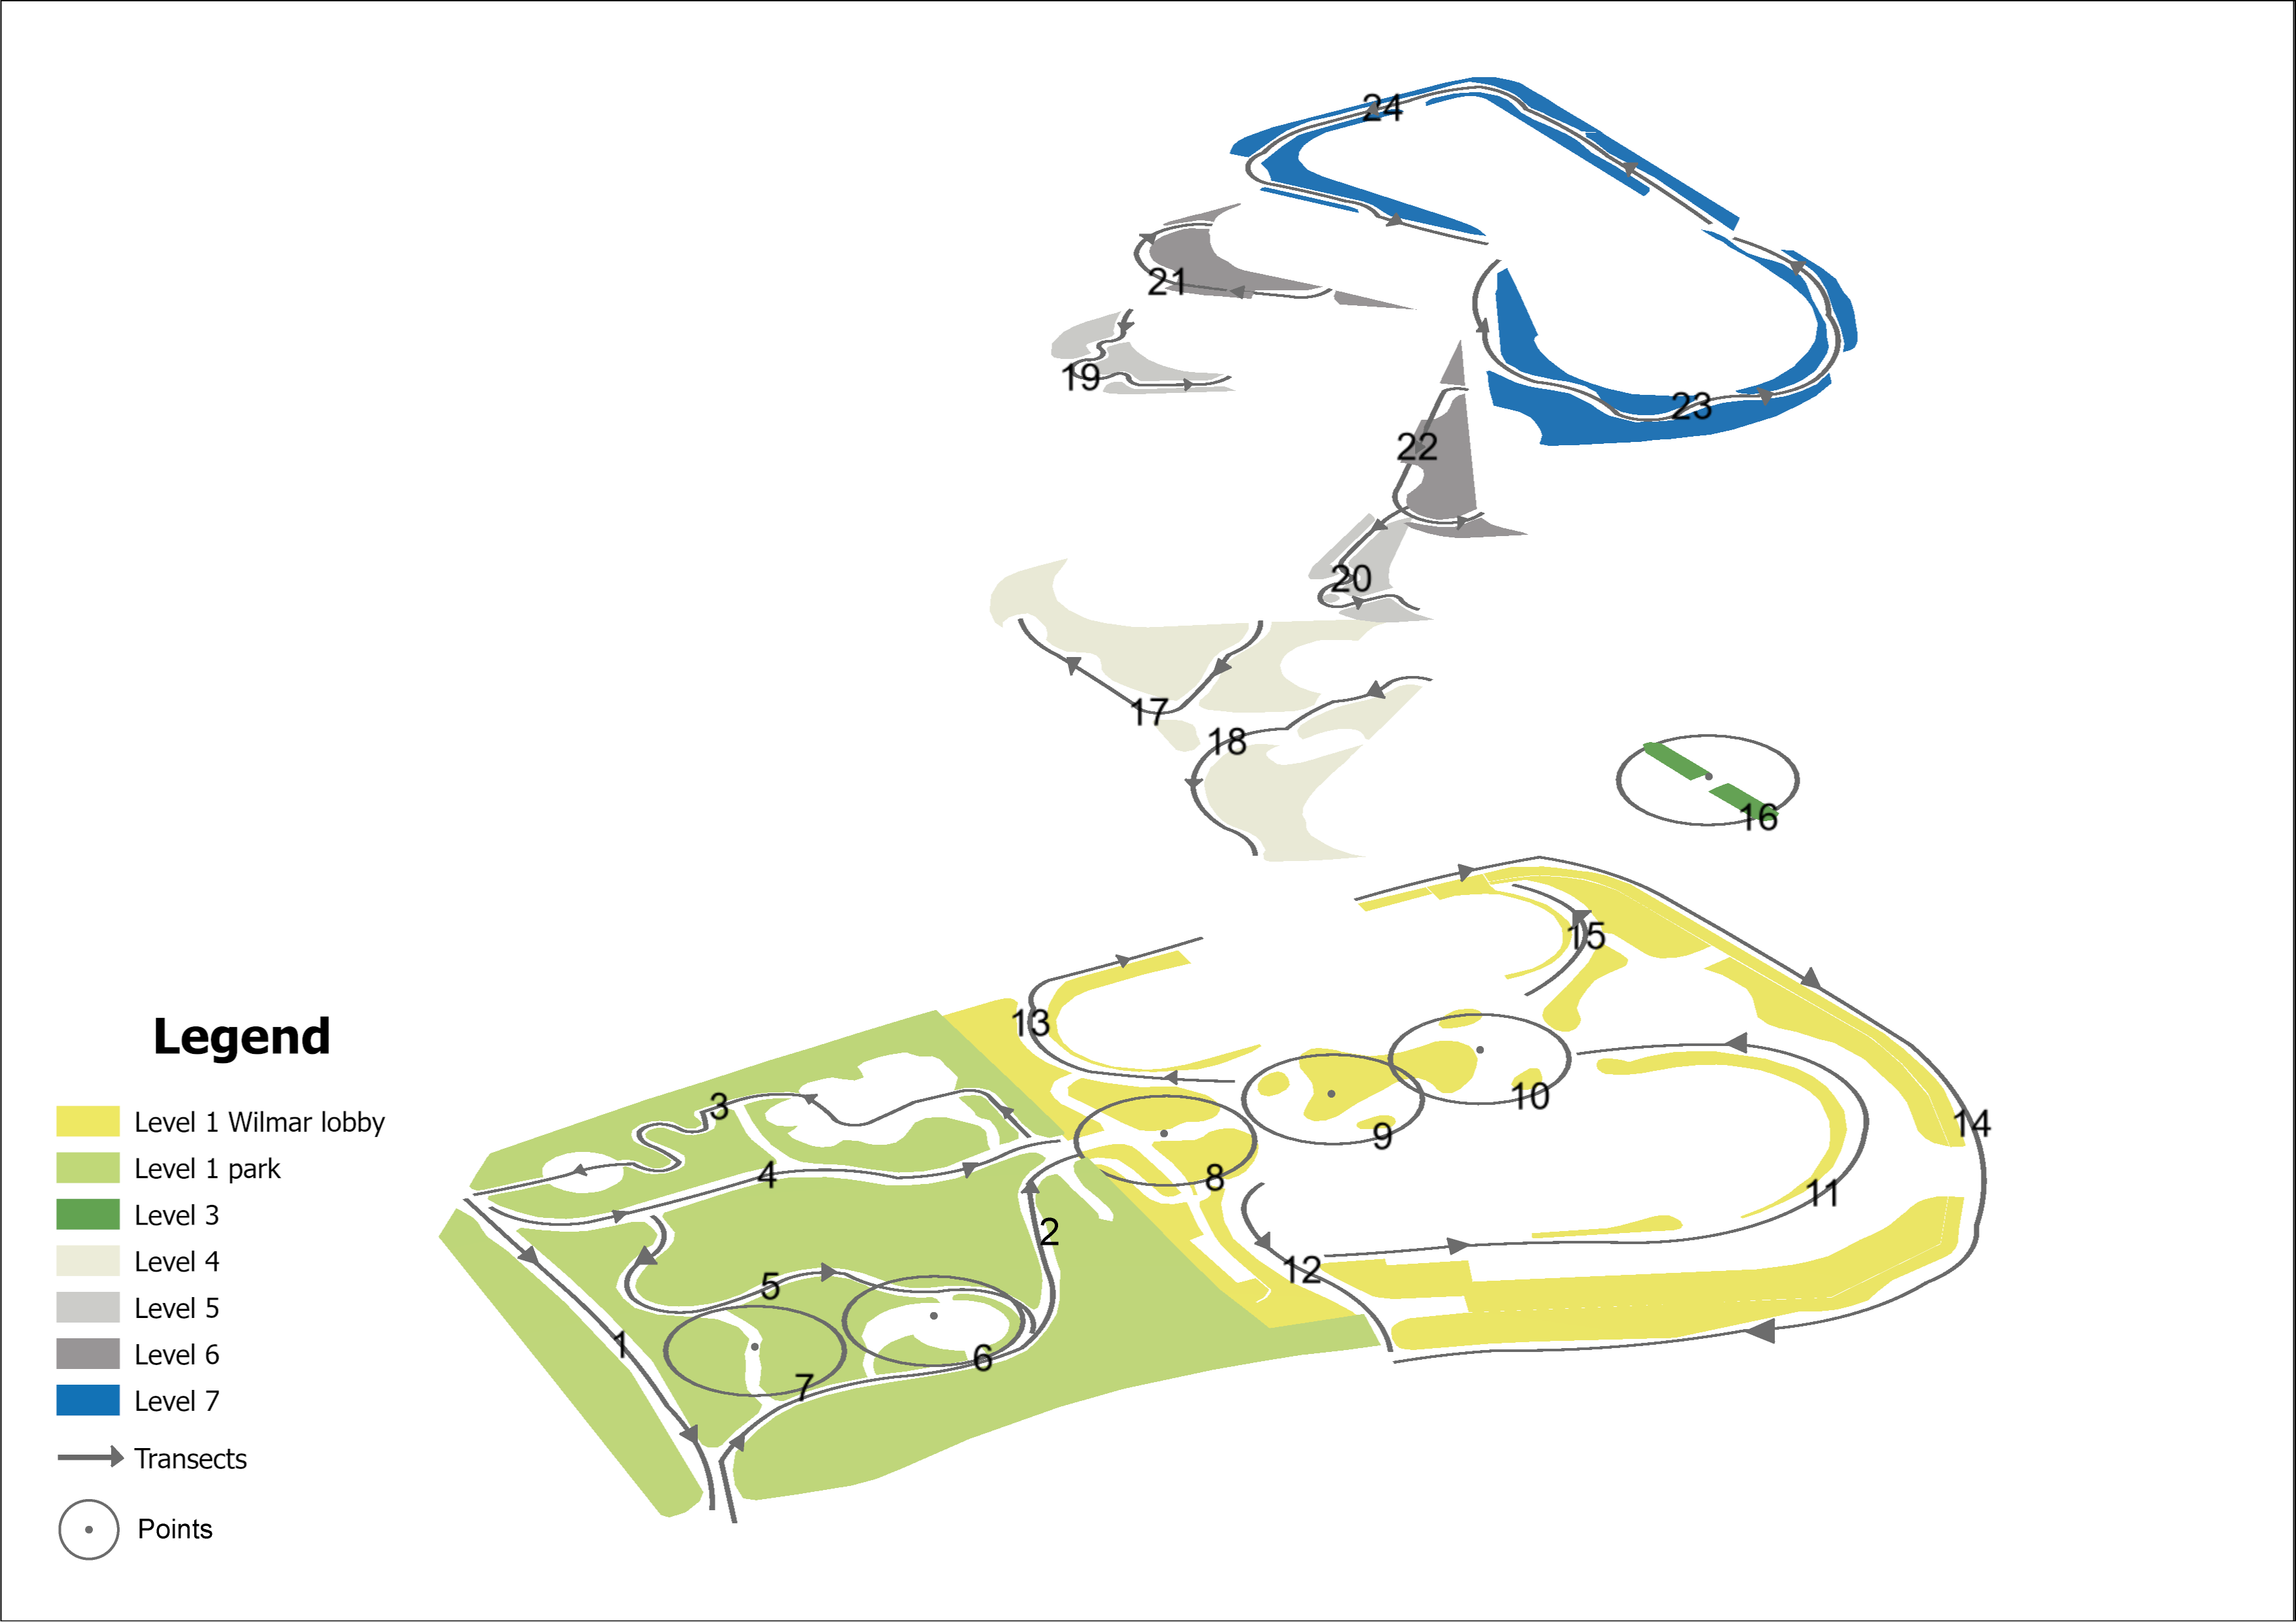
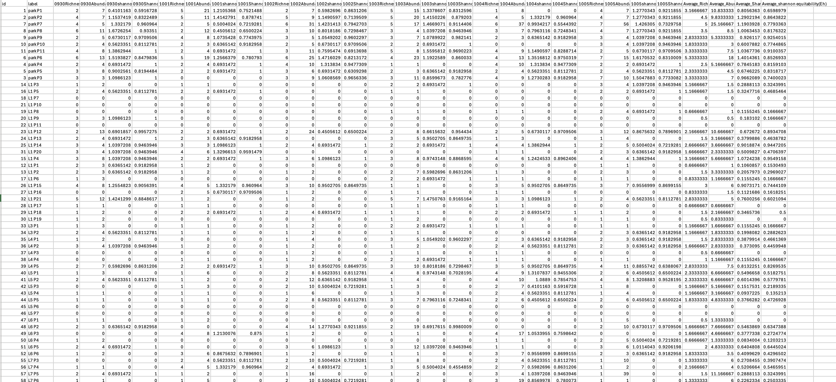
Data – On-Site Survey Results
Biodiversity Field Survey: An on-site survey was carried out to collect observed biodiversity data for each node. Surveyors followed predefined transect routes through and around the building, systematically recording all plant and animal species present at each node and counting the number of individual organisms observed.
Empirical Biodiversity Index: From the survey data, actual biodiversity indices for each node were calculated. These empirical indices quantify the real biodiversity performance of each node. The collected data not only provide a basis for spatial mapping of biodiversity across the site, but also serve as ground truth for validating the predicted scores statistically.

Slide 7
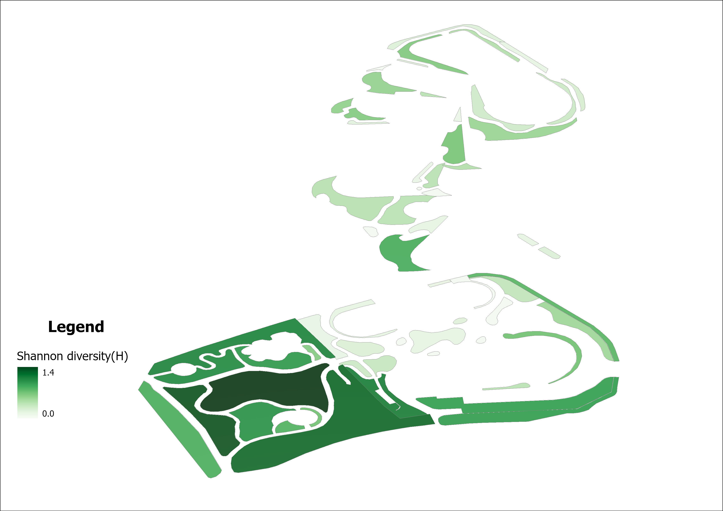
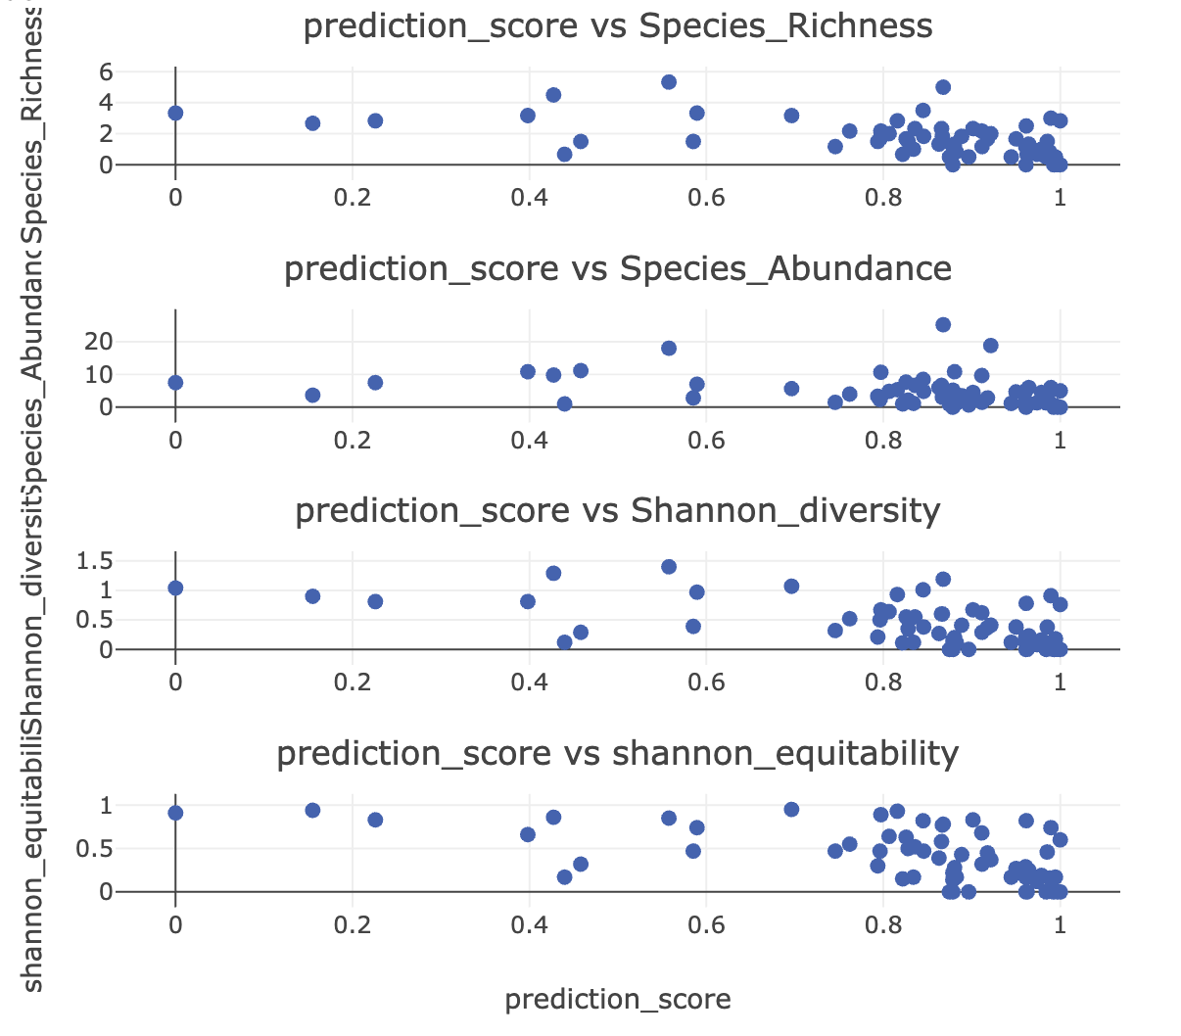
Data visualization plan (chart not finish yet)
2.5D Biodiversity map: Create an interactive 2.5D map of the Wilmar HQ building to visualize biodiversity patterns. On this map, each node will be represented in its real spatial position (across floors), and will show two sets of values – the predicted biodiversity index and the observed index. By using color-coding or height extrusions on the map, viewers can easily see where predicted and actual biodiversity values are high or low. This spatial visualization allows to observe how biodiversity varies vertically and horizontally across the building, highlighting any spatial trends or anomalies in ecological performance.
Scatter Plot (Predicted vs. Observed): In addition, a scatter chart will be used to plot each node’s predicted biodiversity score against its observed biodiversity index. This visualization will reveal the correlation between the expected and actual outcomes. If the points cluster along a rising diagonal trend line, it would indicate that nodes predicted to be rich in biodiversity indeed have high observed biodiversity, validating the design’s effectiveness. Conversely, large deviations would point out where the design over- or under-performed relative to expectations. This scatter plot thus serves as a diagnostic tool to assess whether the vertical greenery design achieved its intended biodiversity improvements at the site.

